Slide 1
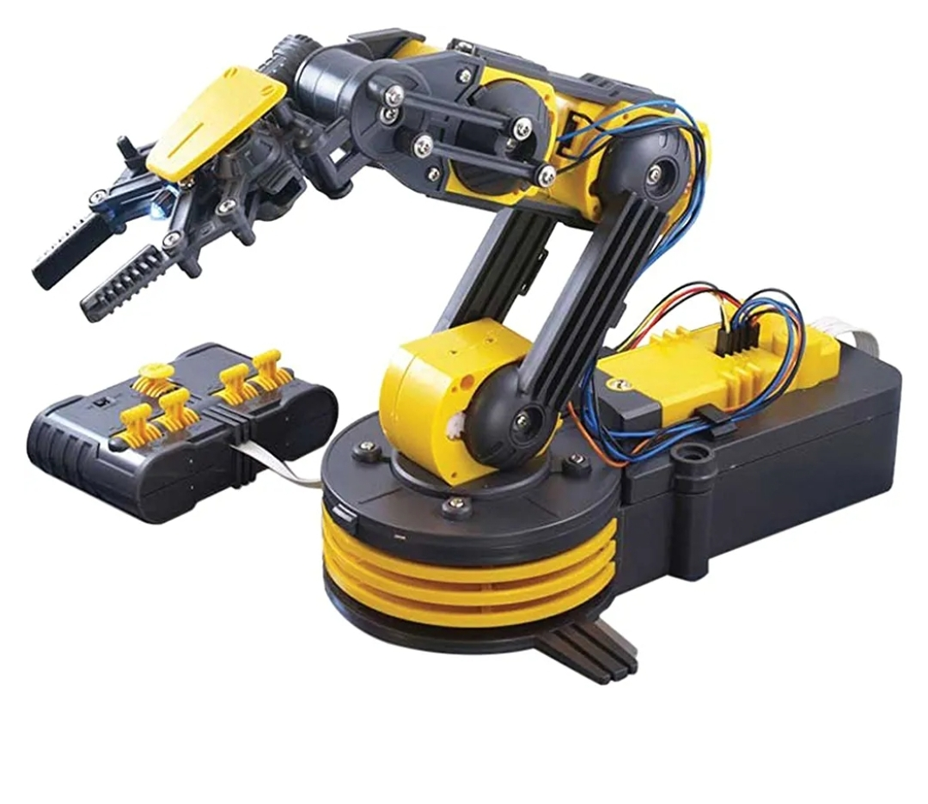
IEEE NITK
ROBOTIC ARM
Mentors
Joel Jojo Painuthara
Sakshi Bothra
Members
Bakti Raju Karchi
Mohammed Shadab Alam
Nithin s
Sonali Kannojiya

Slide 2
Aim
The aim of this project is to simulate a robotic arm using the Robot Operating System (ROS) and
the Gazebo simulator. The project demonstrates the capabilities of ROS in controlling and
simulating robotic systems, while providing a platform for further research and development in the
field of robotics.

Slide 3
Introduction
Robotic systems play a crucial role in various industries, from manufacturing to healthcare. The
ability to accurately simulate and control robotic arms is essential for designing, testing, and
optimizing their performance. The Robot Operating System (ROS) is a flexible framework that
provides tools and libraries for developing robot applications. Gazebo, on the other hand, is a
powerful simulator that allows for realistic physics-based simulations of robots and environments.
This project combines the strengths of ROS and Gazebo to simulate a robotic arm and control it
using a graphical user interface (GUI) generated using the Tkinter library in Python.

Slide 4
Implementation
The implementation of the project involves the following steps:
Designing the Robotic Arm
The robotic arm is designed using CAD software, taking into consideration its kinematics and
mechanical properties. The arm model is then imported into Gazebo for simulation.

Slide 5
Instructions for opening simulation:
Create a catkin workspace and clone the github repo into the src folder
Run catkin build in the catkin workspace
Run source./devel/setup.bash
Type in roslaunch roboticarm gazebo.launchThis will open the simulation
In a new terminal run step 3
6. Then type in rosrun roboticarm claw_control.pyThis will open the controller

Slide 6
Future work
FUTURE SCOPE Robotic Arms have a wide scope of development. Shortly the arms will be able to perform every task as humans and in a much better way. Brain Computer Interface can be used to acquire signals from the human brain and control the arm. The system can work in the same way as a human arm.

Slide 7
Results and Conclusions
ROS is a fairly simple tool to get started with robot software development. The ROS package provided here is easily used for simulation of a virtual robot. The package can be tried with different more meaningful target positions for the robot joints, different interpolations, different operational frequency, and different kinematics features.
The next part of the article series covers extending the package to publish the same target commands to an actual robot for real-time simulation and visualization.

Slide 8
Link of ppt https://1drv.ms/p/s!AkQ9qf2LFRubgnyNfq-yOkwPnZ_L

